Slide 1
Introduction to Data Visualization and Types
Arif Istiake Sunny
Senior AI Engnineer
Brain Staion 23 PLC
Mobile: 01732009493
Email: sunny1506006@gmail.com

Slide 2
Contents
Time Series Data Visualization
Moving Average
Seasonal Decomposition

Slide 3
Time Series Data Visualization
Teacher:
After your fantastic EDA, the mayor gives you a new task.
🌦 “I want to know how the temperature has been changing every month in SunnyVille over the past 10 years,” she says.
Time to dive into Time Series Data!
Story Twist:
You find out that ice cream sales go up when the temperature is high, but power outages also increase. 😅

Slide 4
Time Series Data Visualization
To show this, you use:
Line charts
Moving averages
Seasonal decomposition plots
Area charts to show peak consumption and weather patterns

Slide 5
What is Moving average?
A moving average smooths out short-term fluctuations in your data to help you see trends more clearly.
Instead of showing the raw value at every point (which might be noisy), it shows the average of the last N values — like a rolling window.

Slide 6
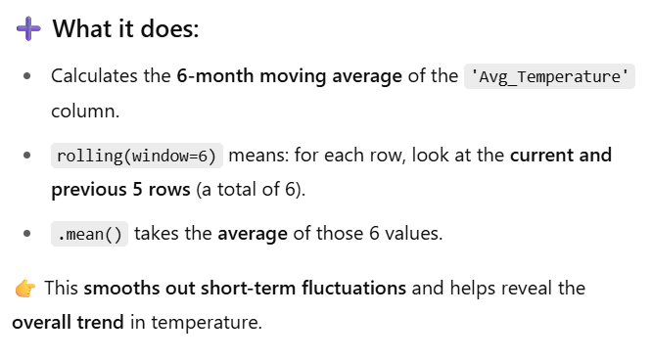
What is Moving average?
df['Temp_MA_6'] = df['Avg_Temperature'].rolling(window=6).mean()

Slide 7
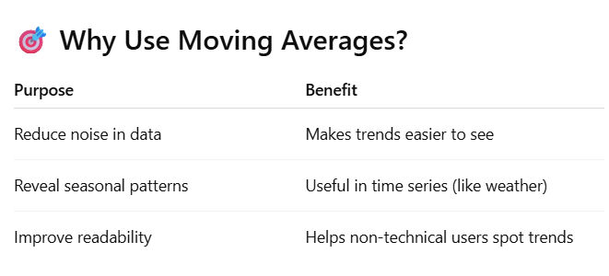
Why Moving average?

Slide 8
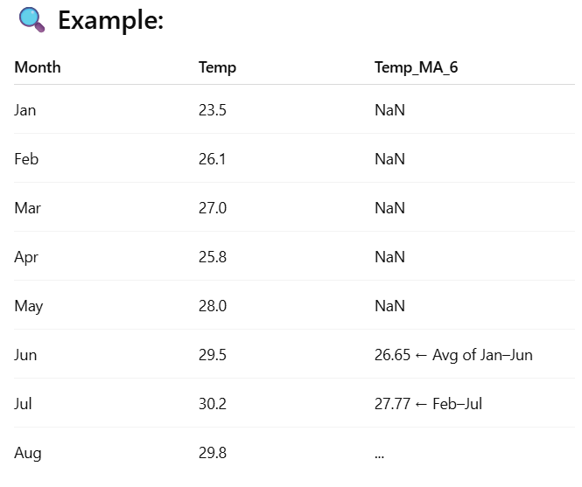
Moving average Example

Slide 9
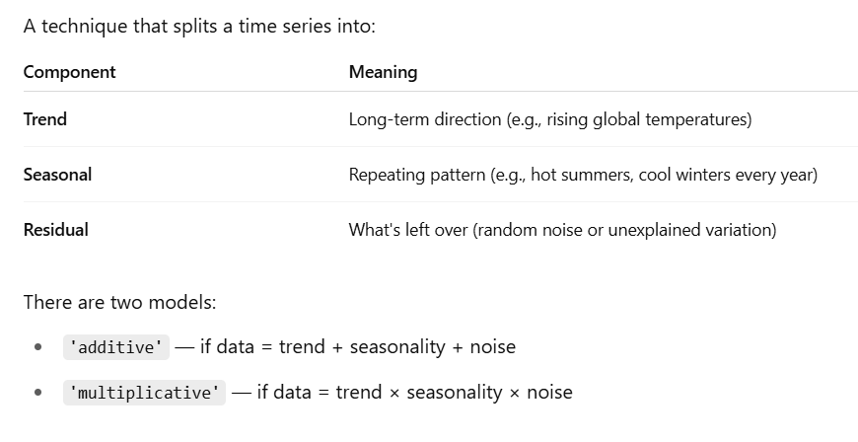
What is seasonal decomposition?

Slide 10
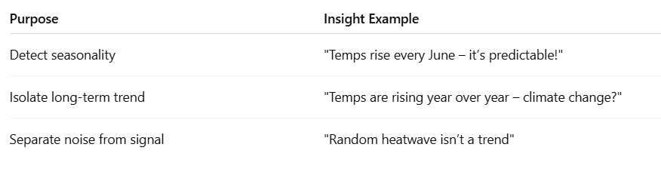
Why It’s Useful?

